Slide 1
The Kingdom New Testament
The way of
Jesus Christ

Slide 2
God with us
God’s will-- to be known.
Emmanuel—God with us.
Just as the old testament is read in the wrong way the New testament even more so.

Slide 3
According as his divine power hath given unto us all things that pertain unto life and godliness, through the knowledge of him that hath called us to glory and virtue: Whereby are given unto us exceeding great and precious promises: that by these ye might be partakers of the divine nature, having escaped the corruption that is in the world through lust. (2 Peter 1:3-4)

Slide 4
Two Kingdoms
Through the Old Testament we saw a theme of two kingdoms. From the perfection of Eden to the original forming of two ways. One of grace and crying to God. The other of Law, force and fear of punishment.

Slide 5
Evil world
Mat 12:25 And Jesus knew their thoughts, and said unto them, Every kingdom divided against itself is brought to desolation; and every city or house divided against itself shall not stand: And if Satan cast out Satan, he is divided against himself; how shall then his kingdom stand?
1Jn 5:19 And we know that we are of God, and the whole world lieth in wickedness.
Eph 2:2 Wherein in time past ye walked according to the course of this world, according to the prince of the power of the air, the spirit that now worketh in the children of disobedience:

Slide 6
The early Church
And he said unto them, The kings of the Gentiles exercise lordship over them; and they that exercise authority upon them are called benefactors. But ye shall not be so: but he that is greatest among you, let him be as the younger; and he that is chief, as he that doth serve. (Luke 22:25-26)

Slide 7
Now and not yet
In the beginning the Kingdom was a garden. In the future it will be over all the earth. For now we are the seeds, ambassadors, foretaste of what that will look like.
Be what is to become.

Slide 8
“Powers of the world to come”
“For it is impossible for those who were once enlightened, and have tasted of the heavenly gift, and were made partakers of the Holy Ghost, And have tasted the good word of God, and the
powers of the world to come,”
Heb 6:4

Slide 9
It’s not about you…
“And when they entered unto the heathen, whither they went, they profaned my holy name, when they said to them, These are the people of the LORD, and are gone forth out of his land. But I had pity for mine holy name, which the house of Israel had profaned among the heathen, whither they went. Therefore say unto the house of Israel, Thus saith the Lord GOD; I do not this for your sakes, O house of Israel, but for mine holy name's sake, which ye have profaned among the heathen, whither ye went.

Slide 10
“Every battle of the warrior…”
“The people that walked in darkness have seen a great light: they that dwell in the land of the shadow of death, upon them hath the light shined. Thou hast multiplied the nation, and not increased the joy: they joy before thee according to the joy in harvest, and as men rejoice when they divide the spoil. For thou hast broken the yoke of his burden, and the staff of his shoulder, the rod of his oppressor, as in the day of Midian. For every battle of the warrior is with confused noise, and garments rolled in blood; but this shall be with burning and fuel of fire.”

Slide 11
A child is born!
For unto us a child is born, unto us a son is given: and the government shall be upon his shoulder: and his name shall be called Wonderful, Counsellor, The mighty God, The everlasting Father, The Prince of Peace. Of the increase of his government and peace there shall be no end, upon the throne of David, and upon his kingdom, to order it, and to establish it with judgment and with justice from henceforth even for ever. The zeal of the LORD of hosts will perform this. (Is 9:2-7)

Slide 12
This is the background we should read the NT.
“And leaving Nazareth, he came and dwelt in Capernaum, which is upon the sea coast, in the borders of Zabulon and Nephthalim: That it might be fulfilled which was spoken by Esaias the prophet, saying, The land of Zabulon, and the land of Nephthalim, by the way of the sea, beyond Jordan, Galilee of the Gentiles; The people which sat in darkness saw great light; and to them which sat in the region and shadow of death light is sprung up. From that time Jesus began to preach, and to say, Repent: for the kingdom of heaven is at hand. (Matthew 4:13-17)”
“Now after that John was put in prison, Jesus came into Galilee, preaching the gospel of the kingdom of God, And saying, The time is fulfilled, and the kingdom of God is at hand: repent ye, and believe the gospel. “ (Mk 1:14-15)

Slide 13
The Christ centered Bible
When we start here, it’s a totally different Bible that “how do I go to heaven”.

Slide 14
“The time is fulfilled”
And he came to Nazareth, where he had been brought up: and, as his custom was, he went into the synagogue on the sabbath day, and stood up for to read. And there was delivered unto him the book of the prophet Esaias. And when he had opened the book, he found the place where it was written,
The Spirit of the Lord is upon me, because he hath anointed me to preach the gospel to the poor; he hath sent me to heal the brokenhearted, to preach deliverance to the captives, and recovering of sight to the blind, to set at liberty them that are bruised, To preach the acceptable year ( the Jubilee) of the Lord. And he closed the book, and he gave it again to the minister, and sat down. And the eyes of all them that were in the synagogue were fastened on him. And he began to say unto them, This day is this scripture fulfilled in your ears. (Luke 4:16-21)

Slide 15
Jesus is the cure!
Jesus offered the cure for humanity. He Created His church as a showcase for His way. And made it the instrument of blessing for the whole world.
More than just the facts…it’s a blueprint!

Slide 16
The Sermon on the Mount comes alive…
7 times Jesus said, I know it has been said , but now I say.
Anger and murder taken even to name calling.
Adultery taken to lust.
Marriage made permanent “as it was in the beginning.”
Revenge put away and now even love of enemy.
Not coveting expanded to surrendering everything.
Judgmentalism put away.
Mat 5:19 Whosoever therefore shall break one of these least commandments, and shall teach men so, he shall be called the least in the kingdom of heaven: but whosoever shall do and teach them, the same shall be called great in the kingdom of heaven.

Slide 17
8th day

Slide 18
What if Jesus really meant every word He said?
A place of repentance, a place of renewal.
A place of saints redeemed by God and implanted by his Spirit.
A place where the rich would say “ouch” and the poor would rejoice.
A place that would manifest God’s cure and dream for humanity.
A place that would act as a mighty Army that would take this kingdom to the end of the earth.
Now …. With that kingdom corrected mindset. Read Jesus.

Slide 19
Do you know Him?
Mat 7:20 Wherefore by their fruits ye shall know them. Not every one that saith unto me, Lord, Lord, shall enter into the kingdom of heaven; but he that doeth the will of my Father which is in heaven. Many will say to me in that day, Lord, Lord, have we not prophesied in thy name? and in thy name have cast out devils? and in thy name done many wonderful works? And then will I profess unto them, I never knew you: depart from me, ye that work iniquity.

Slide 20
Gelassenheit

Slide 21
No Go—No Lo
Mat 28:18 And Jesus came and spake unto them, saying, All power is given unto me in heaven and in earth. Go ye therefore, and teach all nations, baptizing them in the name of the Father, and of the Son, and of the Holy Ghost: Teaching them to observe all things whatsoever I have commanded you: and, lo, I am with you alway, even unto the end of the world. Amen.
Mat 24:14 And this gospel of the kingdom shall be preached in all the world for a witness unto all nations; and then shall the end come.

Slide 22
Do you see the Kingdom?
Jesus answered and said unto him, Verily, verily, I say unto thee, Except a man be born again, he cannot see the kingdom of God. (John 3:3 )
Verily, verily, I say unto thee, Except a man be born of water and of the Spirit, he cannot enter into the kingdom of God. (John 3:5)

Slide 23
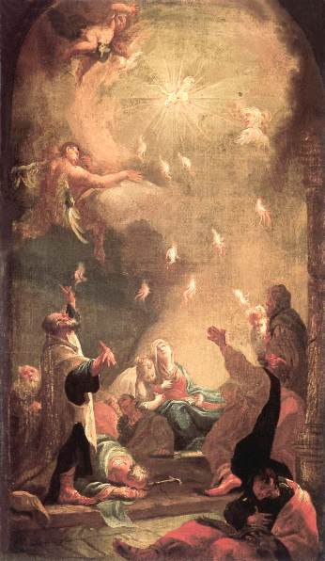
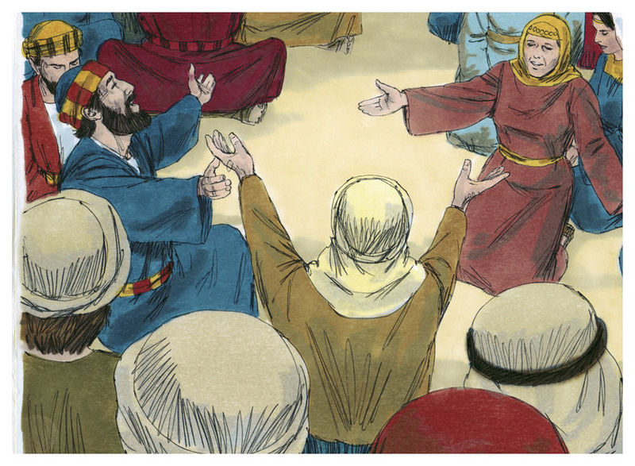
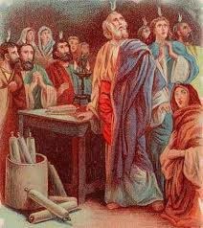
Why Acts makes sense!

Slide 24
What if Jesus really meant every word He said?

Slide 25
You talk too much about kingdom and money?

Slide 26
Misguided simplicity?
Is poverty a blessing?
Godly principles do work. The problem is not that God blesses us materially or through godly principles…the problem is accumulation.
The society that Jesus is describing has rich people coming in saying, “ouch” and the poor people coming in saying, “Yeah!”

Slide 27
Abundance with a +
Mar 10:28 Then Peter began to say unto him, Lo, we have left all, and have followed thee. And Jesus answered and said, Verily I say unto you, There is no man that hath left house, or brethren, or sisters, or father, or mother, or wife, or children, or lands, for my sake, and the gospel's, But he shall receive an hundredfold now in this time, houses, and brethren, and sisters, and mothers, and children, and lands, with persecutions; and in the world to come eternal life.

Slide 28
A new household of abundance!
Give up
Gain 100X!!!
Homes
Brothers
Sisters
Fathers
Mothers
Wife
Children
Lands
Homes
Brothers
Sisters
.
Mothers
.
Children
Lands
Persecution

Slide 29
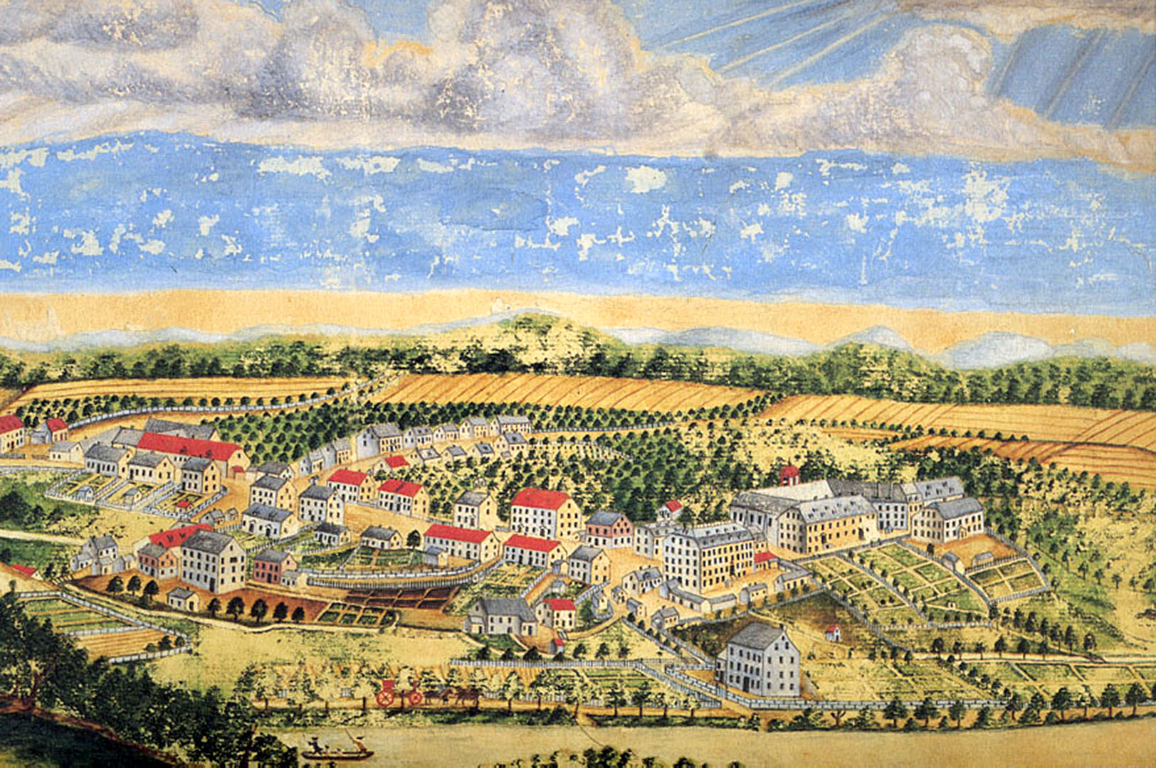
Focus on the mission not on the form.
Herrnhut pictures

Slide 30
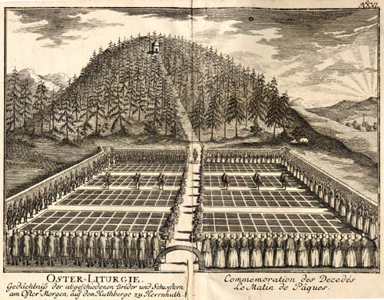

Slide 31
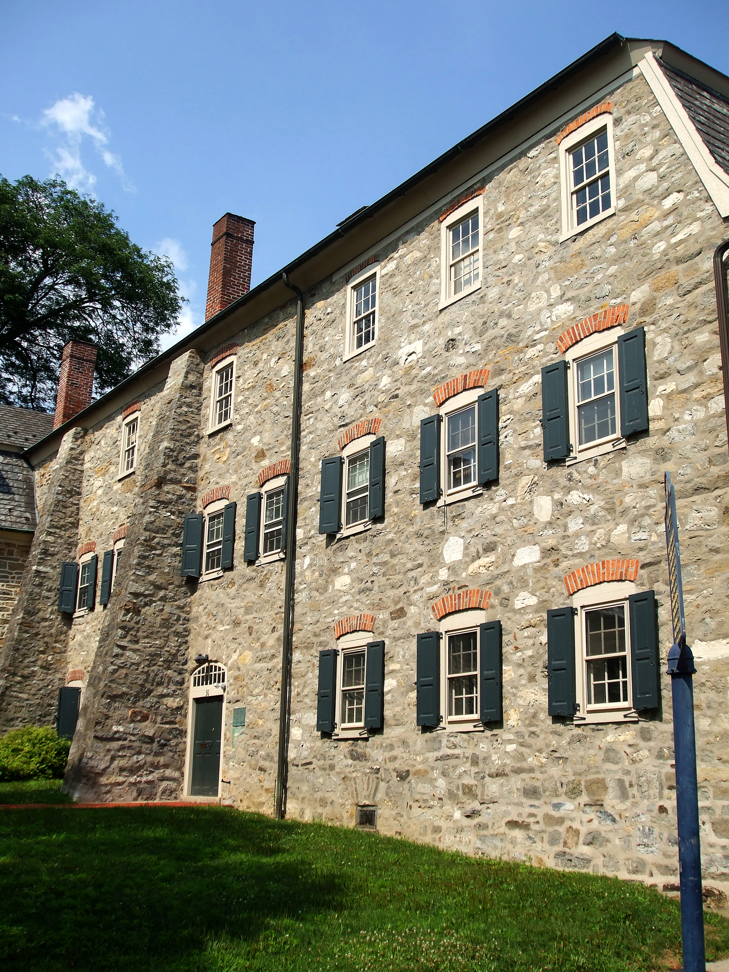

Slide 32
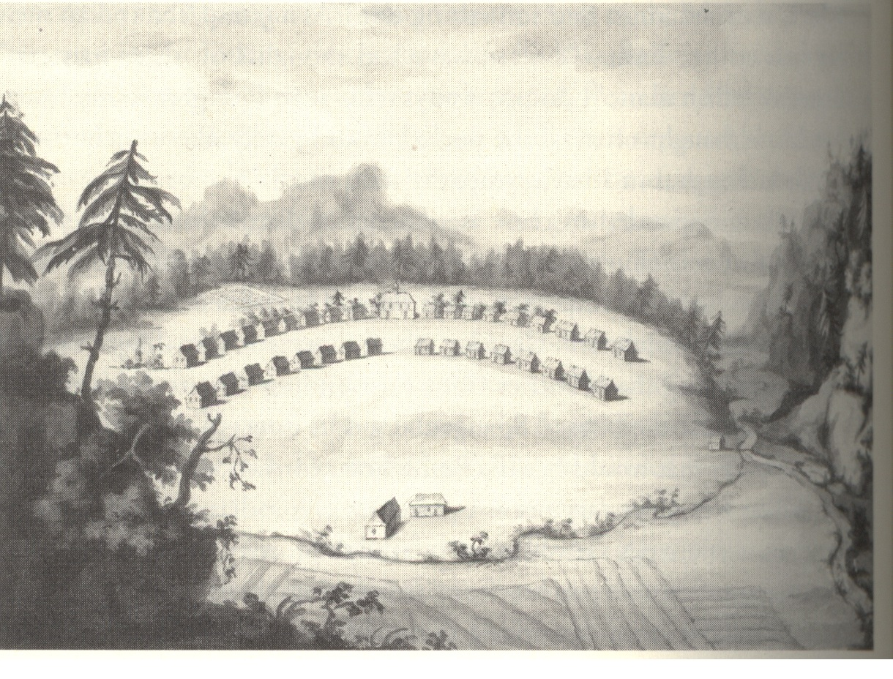

Slide 33
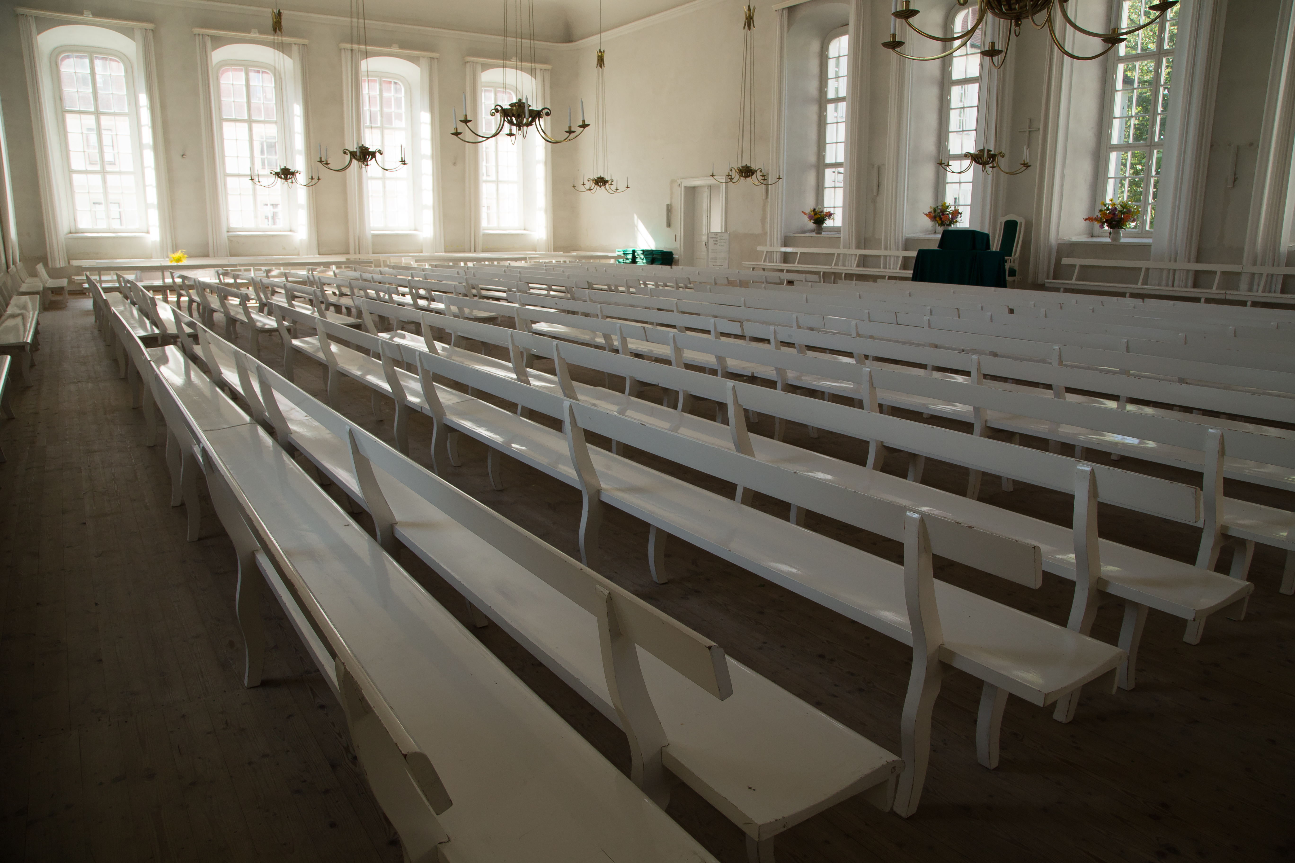

Slide 34
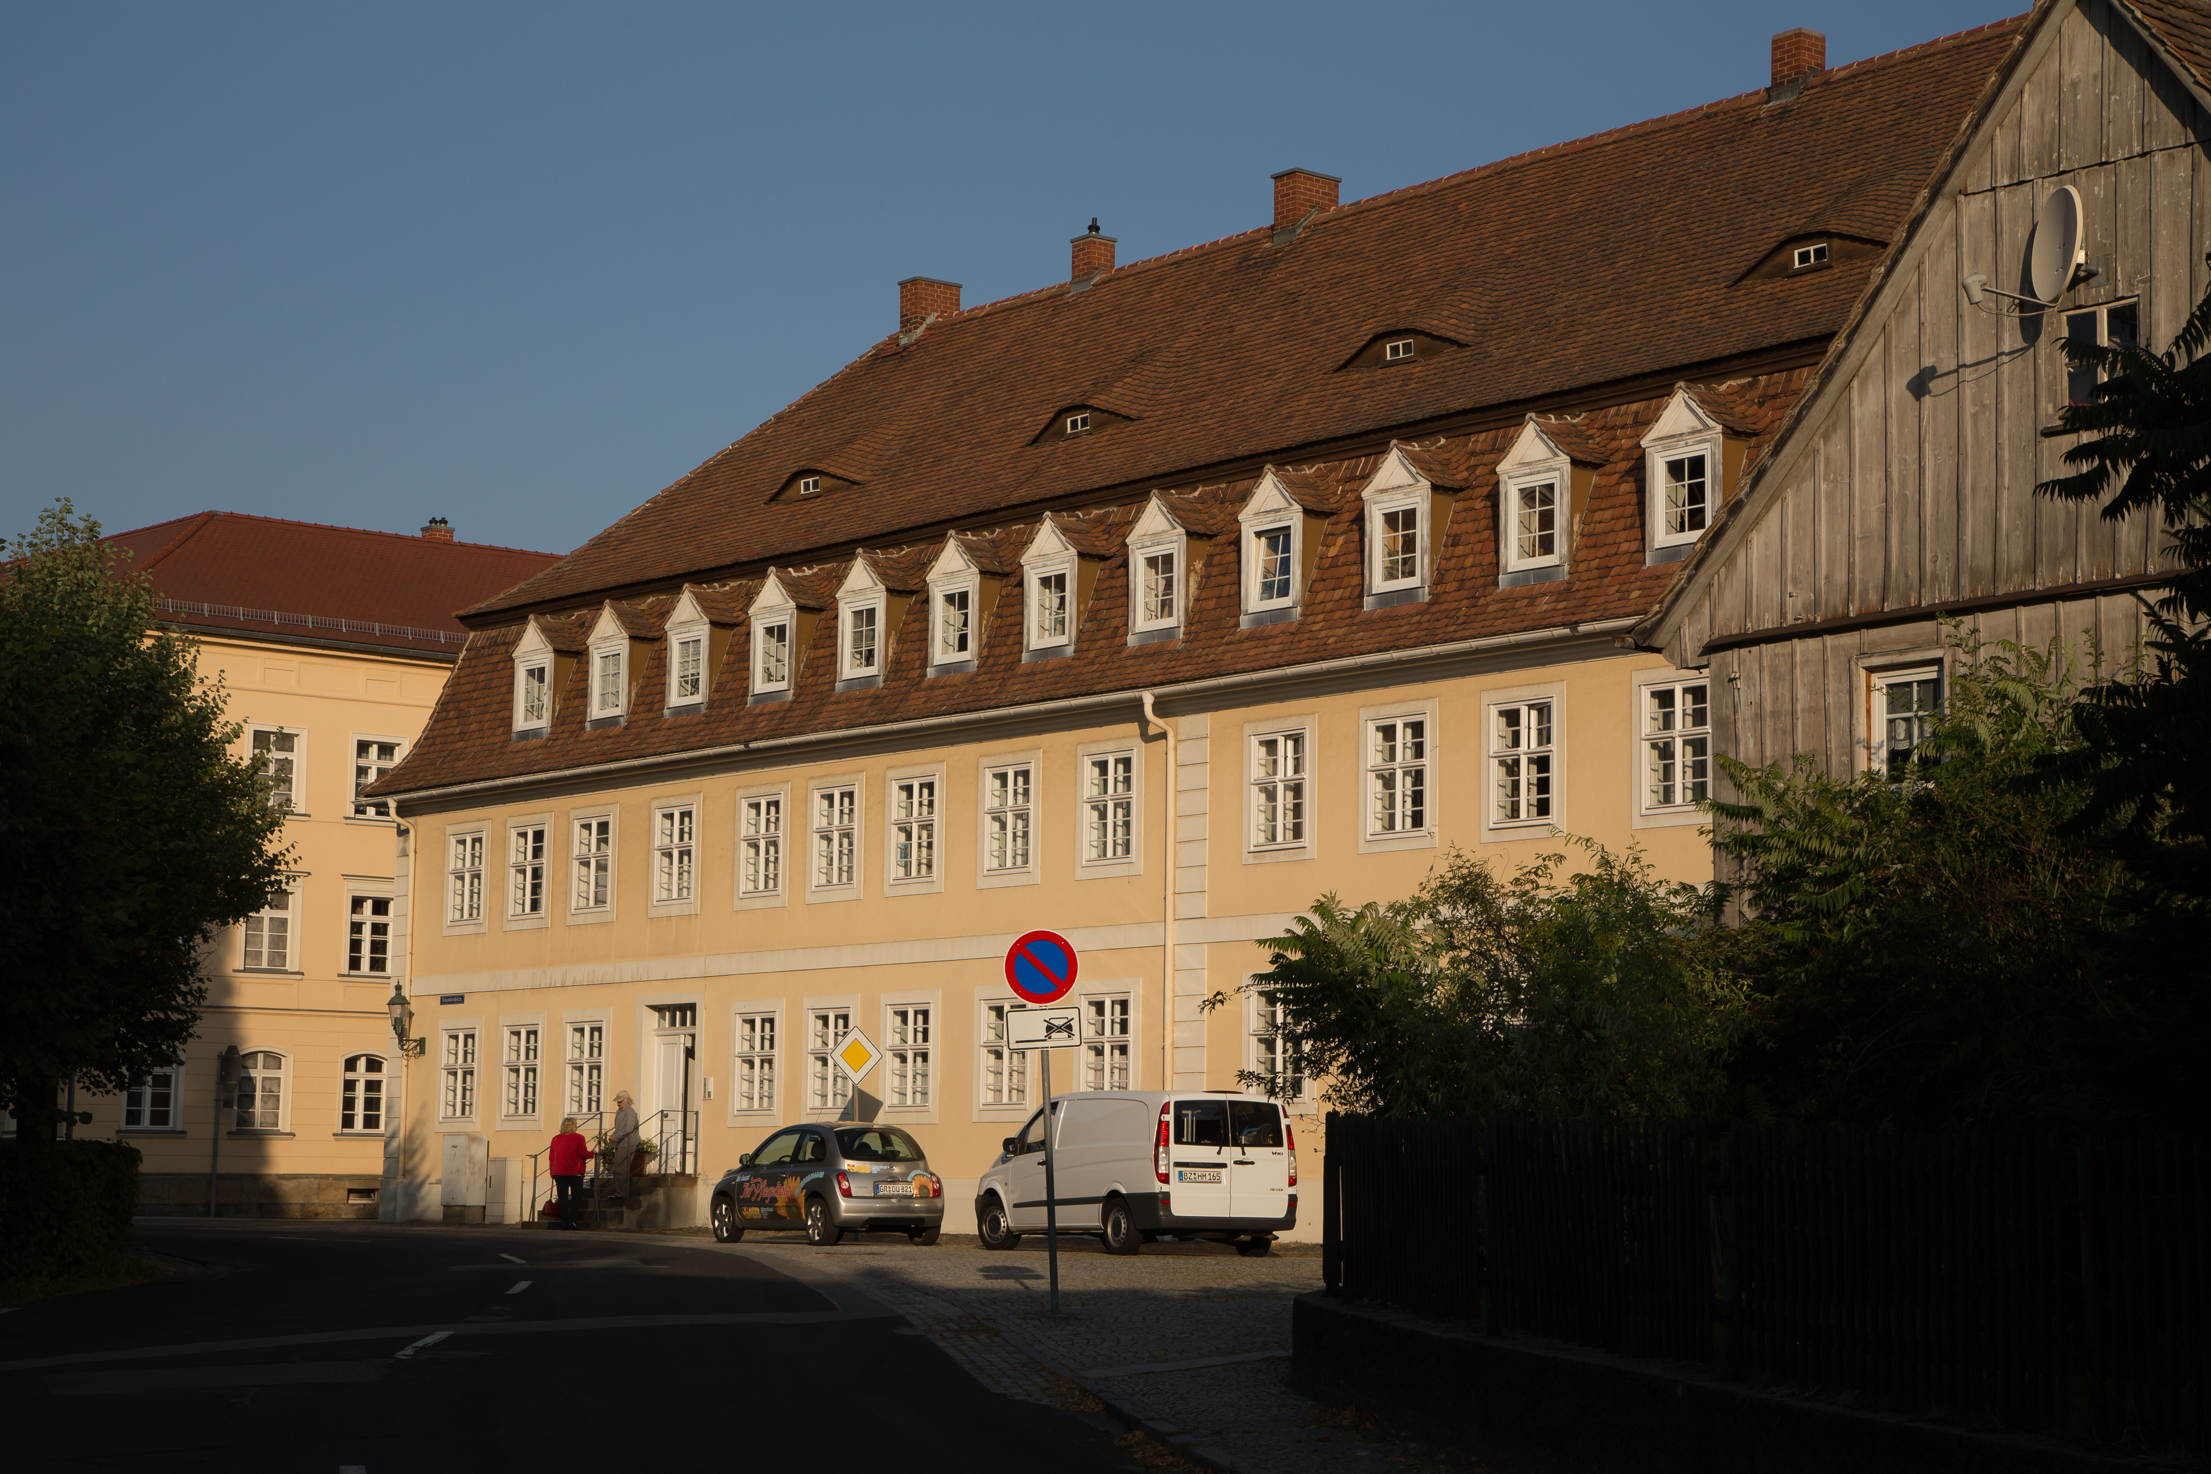

Slide 35
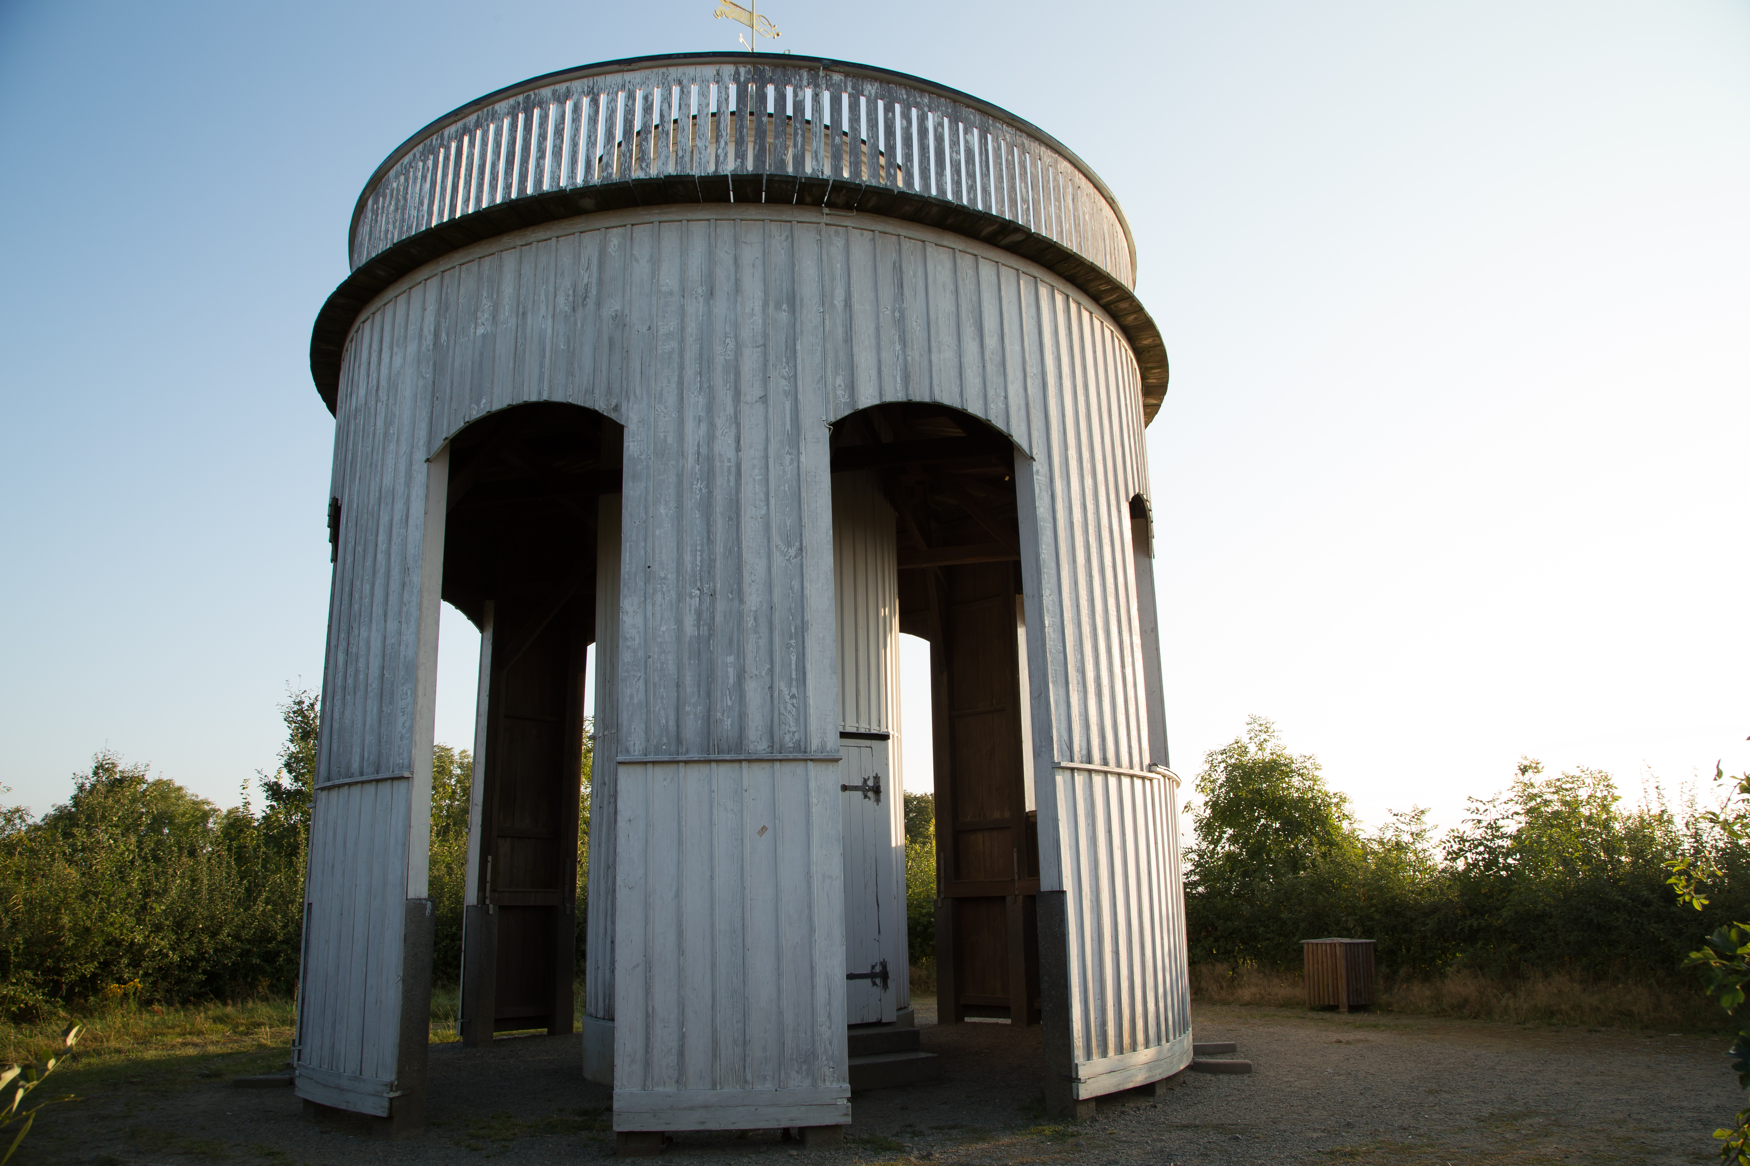

Slide 36
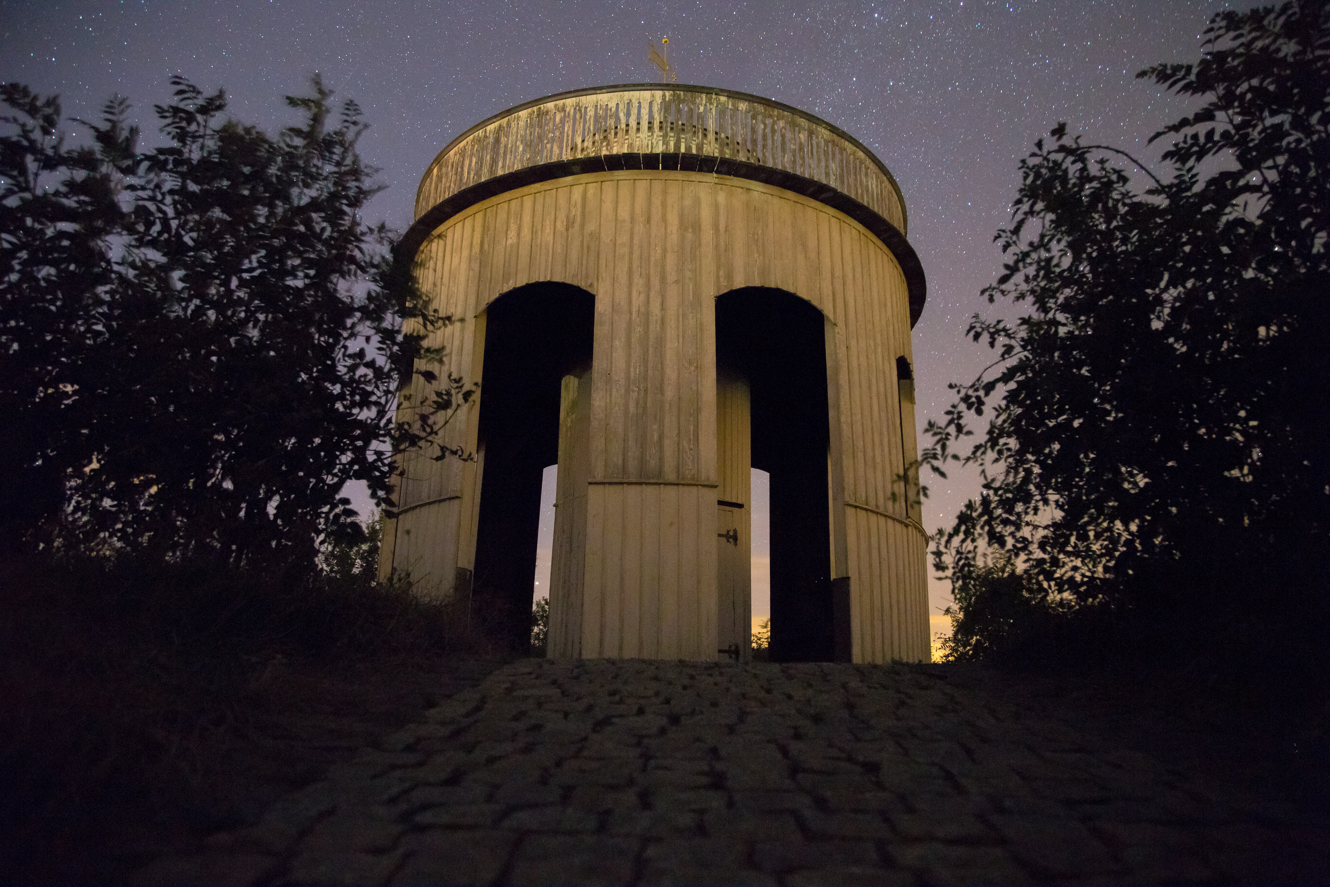

Slide 37
I once asked God why there were so many lost, starving and impoverished people in the world.
But then He asked me the same question.
?

Slide 38
The Kingdom: A place where God would manifest his saving power in real lives.
“And having spoiled principalities and powers, he made a shew of them openly, triumphing over them in it. (Col 2:15)”
“Far above all principality, and power, and might, and dominion, and every name that is named, not only in this world, but also in that which is to come: And hath put all things under his feet, and gave him to be the head over all things to the church, Which is his body, the fulness of him that filleth all in all. (Eph 1:21-23)”

Slide 39
Heavenly stock exchange
Roger Hertzler
We can end up not investing in either kingdom.

Slide 40
Opposition

Slide 41
Bad things people say….
The Words of Jesus are for a different age.
The words of Jesus are for heaven.
The words of Jesus need to be balanced.
The words of Jesus are meant to be analogies not reality.
“The book of Matthew is the not the first book of the New testament it is the last book of the Old Testament.”
The words of Jesus were given before the Holy Spirit.

Slide 42
Stop explaining the words of Jesus away!

Slide 43
Don’t dismiss Jesus!
Examples, metaphors and commands.
Behold the fowls of the air: for they sow not, neither do they reap, nor gather into barns; yet your heavenly Father feedeth them. Are ye not much better than they? (Mat 6:26)
Do not worry.
“The kingdom of God is like a mustard seed”
“Not everyone who says unto me Lord, Lord”

Slide 44
I’m glad that’s not me.
Luke 12 and the rich young ruler.
I heard myself echoing the kind of things that my Army buddies said.
Luk 12:30 For all these things do the nations of the world seek after: and your Father knoweth that ye have need of these things. But rather seek ye the kingdom of God; and all these things shall be added unto you. Fear not, little flock; for it is your Father's good pleasure to give you the kingdom. Sell that ye have, and give alms; provide yourselves bags which wax not old, a treasure in the heavens that faileth not, where no thief approacheth, neither moth corrupteth. For where your treasure is, there will your heart be also.
Let your loins be girded about, and your lights burning; And ye yourselves like unto men that wait for their lord, when he will return from the wedding; that when he cometh and knocketh, they may open unto him immediately.

Slide 45
Judged by His words
He that rejecteth me, and receiveth not my words, hath one that judgeth him: the word that I have spoken, the same shall judge him in the last day. (John 12:48)
And why call ye me, Lord, Lord, and do not the things which I say? (Luke 6:46 )

Slide 46
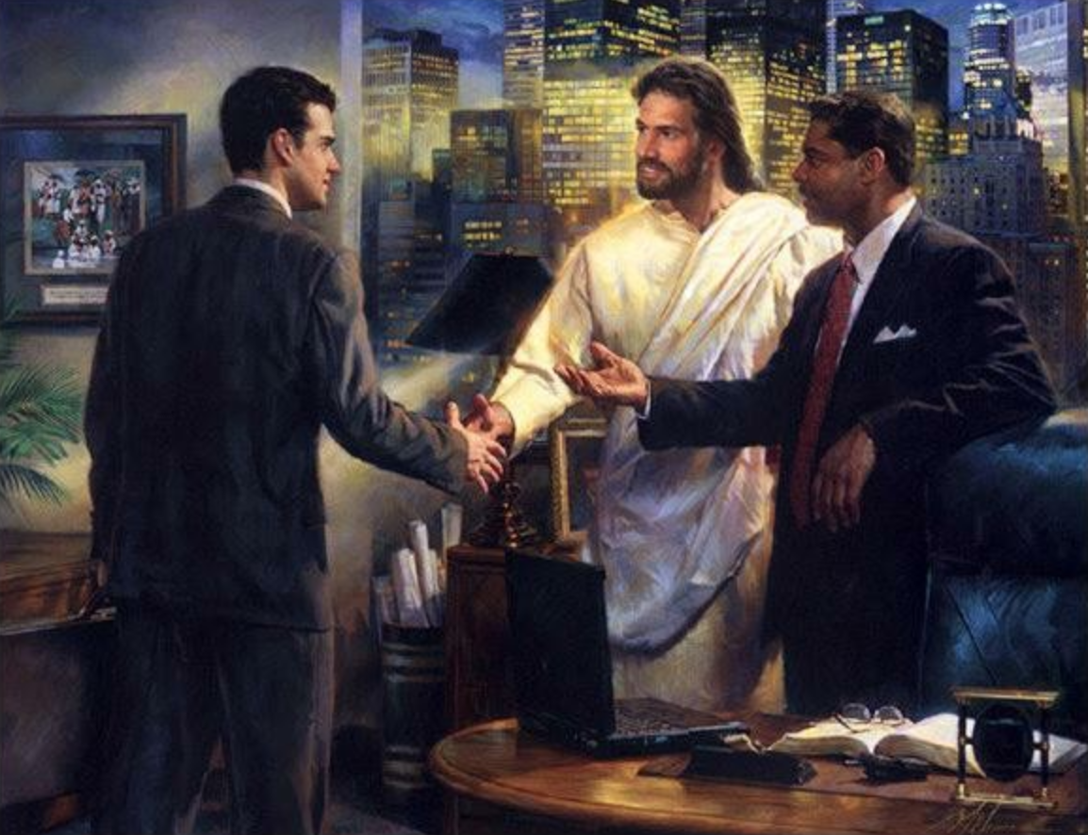

Slide 47
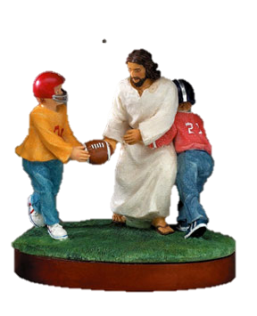

Slide 48
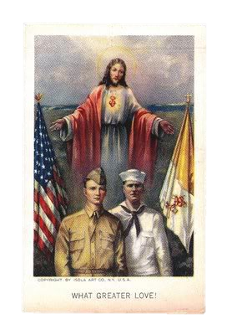
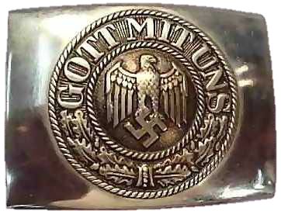

Slide 49
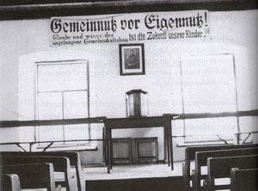

Slide 50
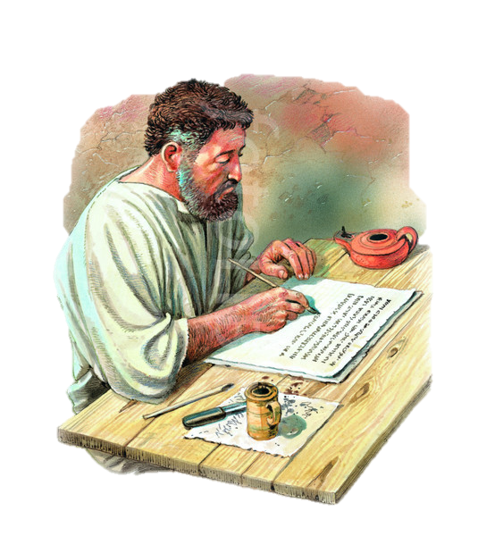
The Kingdom in Paul and the rest of the New Testament
With that kingdom corrected mindset read the book of acts.
With that kingdom corrected mindset read the epistles.
And with that kingdom corrected mindset read Revelation.
Instead of trying to interpret every grasshopper as an apache helicopter and the mark of the beast in every thing from USB code to Ronald Regan’s name. Try understanding that the message of the beast is for all generations.

Slide 51
Epistles
Paul working with a gentile world…
Col 1:13 Who hath delivered us from the power of darkness, and hath translated us into the kingdom of his dear Son:
Heb 12:28 Wherefore we receiving a kingdom which cannot be moved, let us have grace, whereby we may serve God acceptably with reverence and godly fear:
Heb 12:29 For our God is a consuming fire.

Slide 52
Epistles
Teaching them about marriage…
1Co 7:10 And unto the married I command, yet not I, but the Lord, Let not the wife depart from her husband:
Teaching to give sacrificially:
2Co 8:7 Therefore, as ye abound in every thing, in faith, and utterance, and knowledge, and in all diligence, and in your love to us, see that ye abound in this grace also...For ye know the grace of our Lord Jesus Christ, that, though he was rich, yet for your sakes he became poor, that ye through his poverty might be rich.
1Ti 6:18 That they do good, that they be rich in good works, ready to distribute, willing to communicate;
2Co 8:13 For I mean not that other men be eased, and ye burdened: But by an equality, that now at this time your abundance may be a supply for their want, that their abundance also may be a supply for your want: that there may be equality: As it is written, He that had gathered much had nothing over; and he that had gathered little had no lack.

Slide 53
Kingdom in Acts
Act 1:3 To whom also he shewed himself alive after his passion by many infallible proofs, being seen of them forty days, and speaking of the things pertaining to the kingdom of God:
Act 14:21 And when they had preached the gospel to that city, and had taught many, they returned again to Lystra, and to Iconium, and Antioch,
Act 14:22 Confirming the souls of the disciples, and exhorting them to continue in the faith, and that we must through much tribulation enter into the kingdom of God.
Act 20:25 And now, behold, I know that ye all, among whom I have gone preaching the kingdom of God, shall see my face no more.
Act 28:30 And Paul dwelt two whole years in his own hired house, and received all that came in unto him,
Act 28:31 Preaching the kingdom of God, and teaching those things which concern the Lord Jesus Christ, with all confidence, no man forbidding him.

Slide 54
Early Church continued…
Book of Acts saw it as, “the way.”
Justin….when describing Christianity simply say it as followers of Jesus.
Didache describes the faith as two ways and goes on to describe the teaching of Jesus as the Way.

Slide 55
John’s Revelation

Slide 56
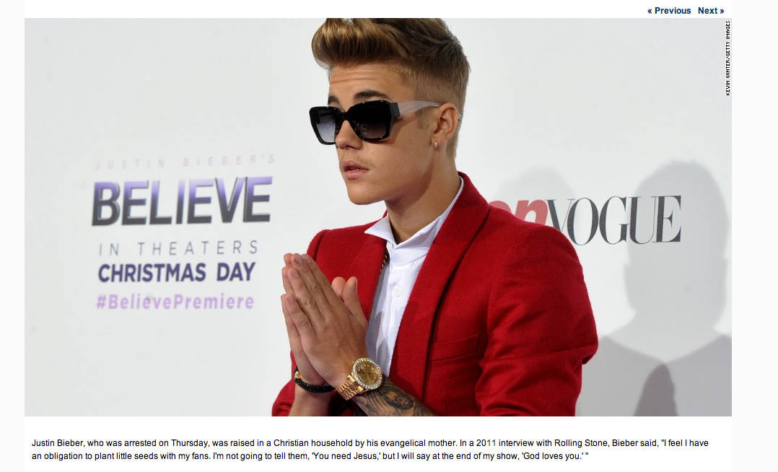
Apache helicopters or retirement funds?
Prophesy is now.

Slide 57
The end times church
Rev 13:9 If any man have an ear, let him hear. He that leadeth into captivity shall go into captivity: he that killeth with the sword must be killed with the sword. Here is the patience and the faith of the saints.
Rev 14:12 Here is the patience of the saints: here are they that keep the commandments of God, and the faith of Jesus.

